Slide 1

THERMOELECTRIC
EFFECTS
The Science of Energy Conversion between Heat & Electricity
By Ehatasham Haque,
Research Assistant (RA) to Dr. Nafisa Noor (NaNr)
North South University, Dhaka.

Slide 2

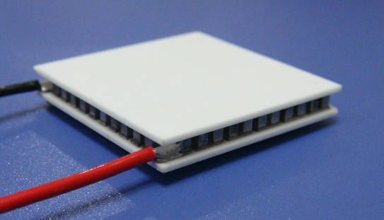
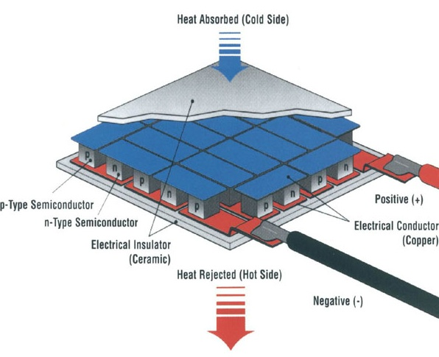
What Are Thermoelectric Effects?
Figure 1. A Micro Thermoelectric Generator (μTEG).
Source: www.electronicsweekly.com
Figure 2. Thermoelectric Generator Diagram.
Source: www.topmagneticgenerator.com

Slide 3



The Three Thermoelectric Effects
SEEBECK
PELTIER
THOMSON
Heat → Electricity
Electricity → Cooling/Heating
Unified Theory
1821
Thomas Seebeck
1834
Jean Peltier
1851
William Thomson
(Lord Kelvin)
Temperature difference creates voltage
Current flow creates temperature difference
Connects all thermoelectric phenomena

Slide 4

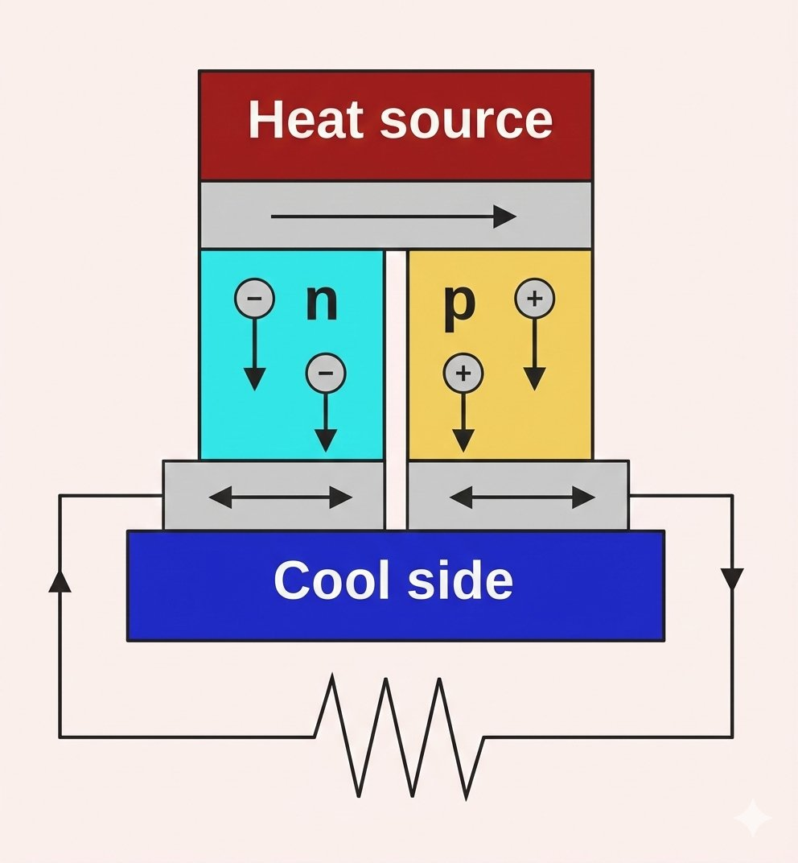
SEEBECK EFFECT
Definition:
Temperature gradient directly converts into electricity. Two dissimilar conductors generate voltage when subjected to heat difference.
Formula:
ES = −α∇T
Unit: μV/K
Figure 3. A generic setup diagram for Thermoelectric generator (TEG) showing Seebeck Effect in action.
Source: Gemini AI infused Image by Science ABC - Venkatesh Vaidyanathan.

Slide 5

SEEBECK EFFECT: Real-World Applications
Thermocouples
Power Generation
Temperature Measurement
Thermoelectric Generators (TEGs)
• Industrial processes
• Scientific research
• Manufacturing quality control
• Highly accurate and reliable
• NASA spacecraft (Voyager, Mars rovers)
• Automotive waste heat recovery
• Remote sensors & IoT devices
• Industrial heat recovery

Slide 6
PELTIER EFFECT
Definition:
Historical Discovery
Electric current creates heating or cooling at junctions. Heat absorbed at one junction, released at another - direction depends on current flow.
Discovered in 1834 by French physicist Jean Charles Athanase Peltier.
He found that electric current flowing through junctions of dissimilar metals either absorbed or released heat depending on current direction.
This was the inverse of Seebeck's discovery, unlocking thermoelectric cooling!
Formula:
QP = Π·I
Units: W (Watts) for heat
V (Volts) for coefficient

Slide 7

PELTIER EFFECT APPLICATIONS
Cooling
Systems
Industrial
Applications
Medical &
Scientific
Portable coolers, wine fridges, electronic component cooling
Temperature control in manufacturing, lab equipment
PCR machines, medical refrigeration, precision instruments

Slide 8
THOMSON EFFECT - The Unifying Theory
Definition:
THE KELVIN RELATIONS
Heating or cooling of a current-carrying conductor with a temperature gradient. Heat absorbed or released throughout the conductor, beyond Joule heating.
William Thomson (Lord Kelvin) unified all three effects in 1851.
He proved that Seebeck, Peltier, and Thomson coefficients are interconnected through thermodynamic principles.
This completed the theoretical framework of thermoelectricity!
Formula:
qT = −K·J·∇T
Unit: V/K

Slide 9



Complete Thermoelectric Heat Balance
q = ρJ² + αJ∇T + τJ(dT/dx) − κ(d²T/dx²)
1. JOULE HEATING
2. PELTIER EFFECT
ρJ² or I²R
ΠI or αTJ
Resistive losses (always positive)
Heat at junctions (± reversible)
3. THOMSON EFFECT
4. FOURIER CONDUCTION
τJ(dT/dx)
−κ(d²T/dx²)
Heat along gradient (± reversible)
Thermal conduction (hot → cold)

Slide 10
KEY TAKEAWAYS
1
SEEBECK: Heat → Electricity (Thermocouples, Power Generation)
2
PELTIER: Electricity → Cooling/Heating (Refrigeration, Electronics)
3
THOMSON: Unified Theory (Kelvin Relations connect all effects)
4
The Complete Thermoelectric equation that
governs all thermoelectric device performance

Slide 11











COMSOL Simulation Checklist
1
Model Wizard
✓
Error 404!
2
Checks Not Found…
✓
Space Dimension
✓
3
Select Physics
✓
4
Select Study
✓
5
Build Geometry
✓
6
Declare Materials
✓
7
Boundary Conditions
✓
8
Mesh Generation
✓
9
Compute Solution
✓
10
Post-Processing
✓

